Slide 1

LIBRARY MANAGEMENT SYSTEM
Submitted by:
Munaza Malik (44956)
Submitted to:
Ma’am Kausar

Slide 2

TABLE OF CONTENTS
01
02
Objective Outcome
Overview Linux environment Shell Scripting
03
Key Features of LMS
04
05
Functionalities Implemented
Future Enhancements
Project: Library Management System
2

Slide 3
Overview
Project: Library Management System
3

Slide 4
Project: Library Management System
Overview
The Library Management System project aims to replace traditional paper-based library processes with an automated solution using Linux-based scripting. Built with Bash, this system provides a simple command-line interface to manage books and students, including adding, updating, and deleting records. It features secure staff login and automatically calculates penalties for late book returns, making library operations faster and more efficient.
4

Slide 5
Project: Library Management System
Linux Environment
The Library Management System operates seamlessly in a Linux environment, utilizing Bash scripting to automate and manage library processes effectively. Linux provides a secure, reliable, and highly customizable platform for executing scripts. Its command-line interface enhances the system's flexibility and performance, making it an ideal choice for this project.
5

Slide 6
Project: Library Management System
Shell Scripting
This project is built using Bash shell scripting, a powerful tool in Linux for automating repetitive tasks, managing arrays, and processing user input. Bash scripting is lightweight, easy to use, and widely supported across Linux distributions. It enables direct interaction with the Linux kernel for efficient resource management.
6

Slide 7
Objective & Outcome
Project: Library Management System
7

Slide 8
Project: Library Management System
Objective
The primary goal is to automate library operations and reduce administrative workload. By developing a user-friendly script, the system ensures secure access, efficient book handling, and accurate penalty tracking, ultimately improving overall library management.
8

Slide 9
Project: Library Management System
Outcome
The system demonstrates how Bash scripting can be effectively used to develop a functional and efficient library management solution. It streamlines processes, reduces manual errors, and ensures data organization. This project showcases the potential of shell scripting in solving practical challenges in small to medium-scale environments.
9

Slide 10
Key Features
Project: Library Management System
10

Slide 11
Project: Library Management System
Key Features
Admin Login System
Book Management
Student Management
Book Issuing and Return Tracking
Penalty System
11

Slide 12
Project: Library Management System
Key Features
Admin Login System:
Secure access to library functions for authorized personnel only.
12

Slide 13
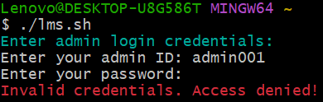
Project: Library Management System
Key Features
Admin Login System:
Secure access to library functions for authorized personnel only.
13

Slide 14
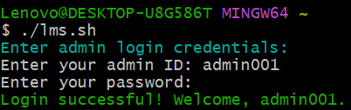
Project: Library Management System
Key Features
Admin Login System:
Secure access to library functions for authorized personnel only.
14

Slide 15
Project: Library Management System
Key Features
Main Menu Navigation:
main_menu function displays options for managing books, students, and issuing books. Only accessible after a successful login.
15

Slide 16
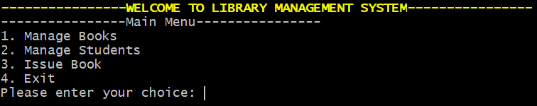
Project: Library Management System
Key Features
Main Menu Navigation:
main_menu function displays options for managing books, students, and issuing books. Only accessible after a successful login.
16

Slide 17
Project: Library Management System
Key Features
Book Management:
Add, update, delete, and search books with real-time inventory updates
Functions like add_book, edit_book, delete_book, search_book and view_books allow for managing book details.
issue_book and return_book handle issuing and returning books while also managing penalties for late returns.
17

Slide 18
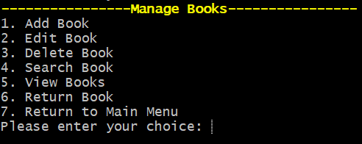
Project: Library Management System
Key Features
Book Management:
18

Slide 19
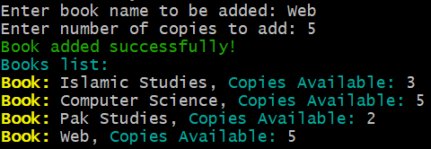
Project: Library Management System
Key Features
Add Books:
19

Slide 20
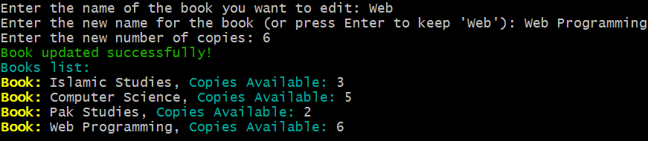
Project: Library Management System
Key Features
Edit Books:
20

Slide 21
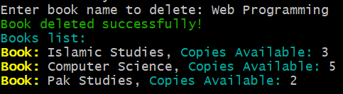
Project: Library Management System
Key Features
Delete Books:
21

Slide 22

Project: Library Management System
Key Features
Search Books:
22

Slide 23

Project: Library Management System
Key Features
View Books:
23

Slide 24

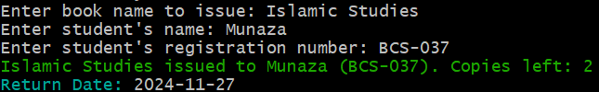
Project: Library Management System
Key Features
Issue Books:
24

Slide 25

Project: Library Management System
Key Features
Return Books:
25

Slide 26
Project: Library Management System
Key Features
Student Management:
Maintain detailed records of students, including books issued to them.
Functions such as add_student, delete_student, and view_students handle CRUD operations for student records.
26

Slide 27
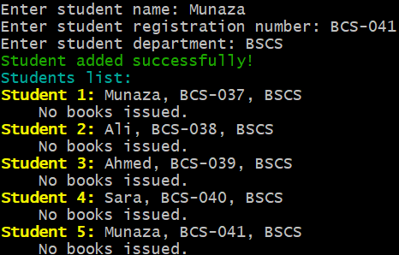
Project: Library Management System
Key Features
Add Student:
27

Slide 28
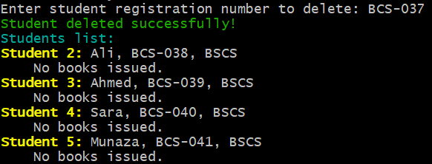
Project: Library Management System
Key Features
Delete Student:
28

Slide 29
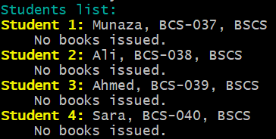
Project: Library Management System
Key Features
View Student:
29

Slide 30
Project: Library Management System
Key Features
Penalty Calculation for Late Returns:
Automate book issuance with return date calculations and penalties for late returns.
The return_book function calculates a penalty if the book is returned after the due date, displaying the amount based on a dailyPenalty rate.
30

Slide 31
Project: Library Management System
Key Features
Penalty Calculation for Late Returns:
31

Slide 32
Functionalities Implemented
Project: Library Management System
32

Slide 33
Project: Library Management System
Functionalities Implemented
Core Functions:
Add, delete, and view books and students.
Check availability and issue books.
Security:
Admin login via ID and password authentication.
Automation:
Simplified library operations directly from the terminal.
Minimizes paperwork and manual tasks.
33

Slide 34
Future Enhancements
Project: Library Management System
34

Slide 35
Project: Library Management System
Future Enhancements
Database Integration: Transition from arrays to databases like MySQL for handling large-scale data.
Graphical User Interface (GUI): Create a GUI for non-technical users to interact with the system more easily.
Email Notifications: Automate email or SMS reminders for due dates and overdue penalties.
Advanced Search Options: Enable book and student searches with filters and partial matching.
Usage Analytics: Introduce reporting tools to analyze borrowing trends and resource usage.
These enhancements will make the system scalable, user-friendly, and suitable for more complex library environments.
35

Slide 36
Conclusion
Project: Library Management System
Bash scripting provides a fast, flexible solution for library management.
Command-line commands streamline user interaction and data management.
36

Slide 37

Any question
Project: Library Management System
37

Slide 38
THANK YOU
Project: Library Management System
38

